Slide 1
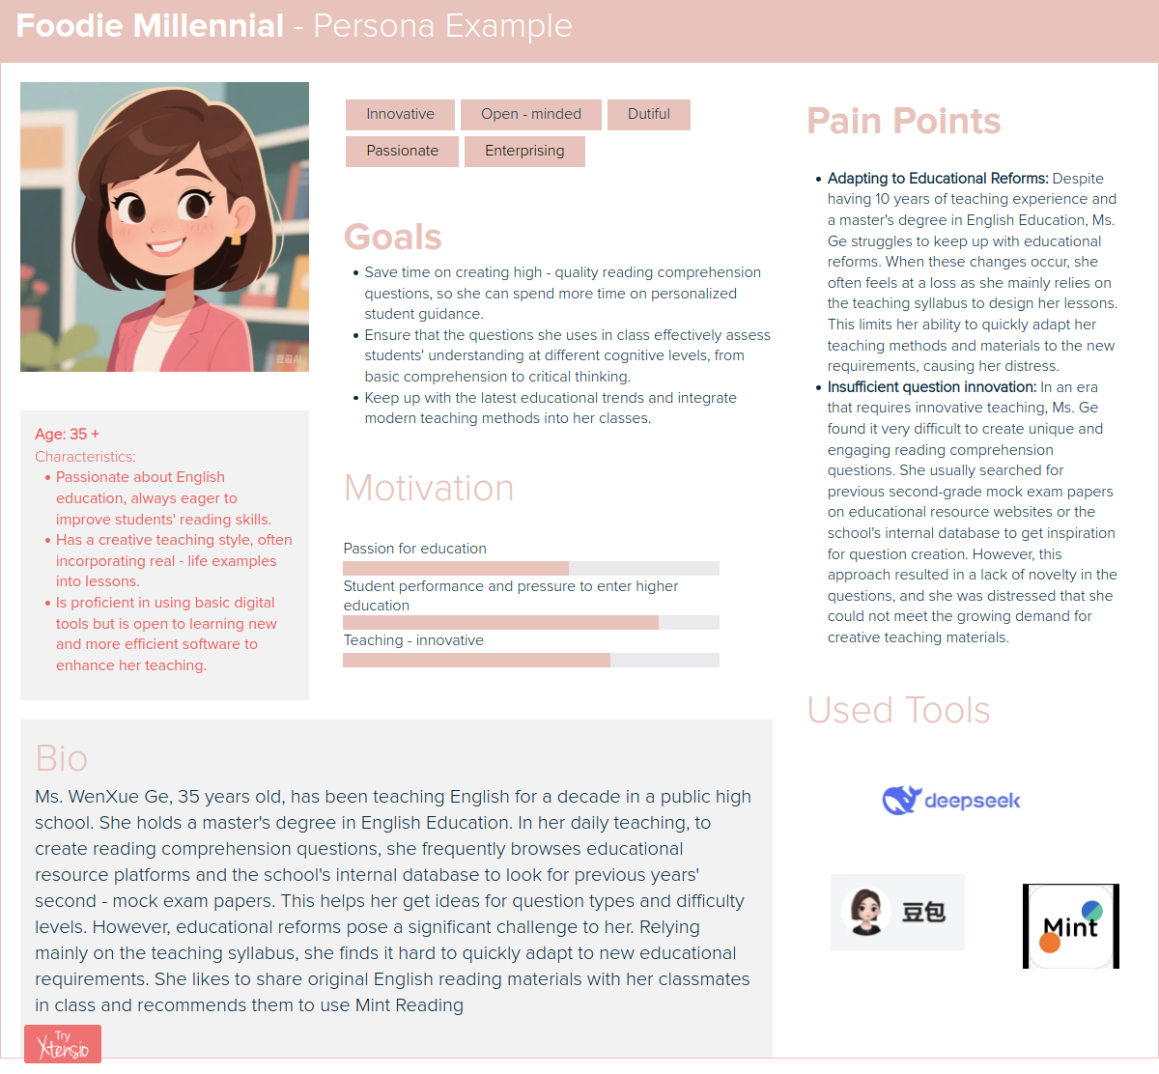
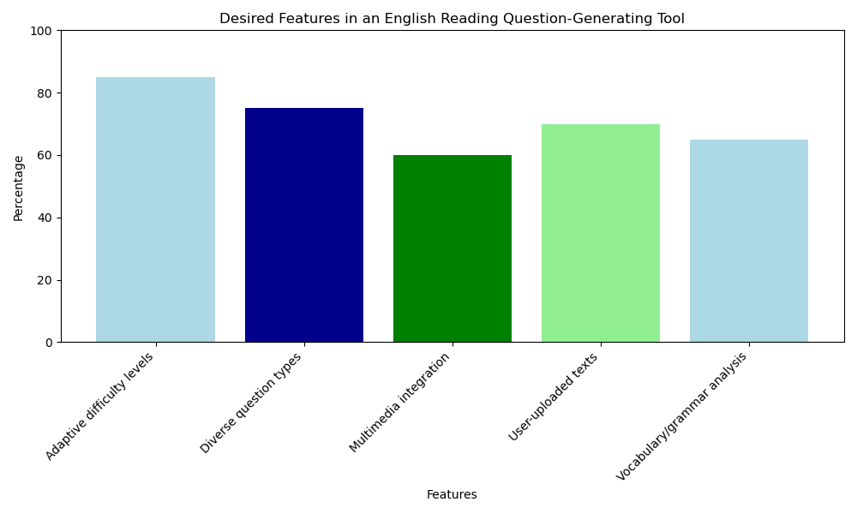
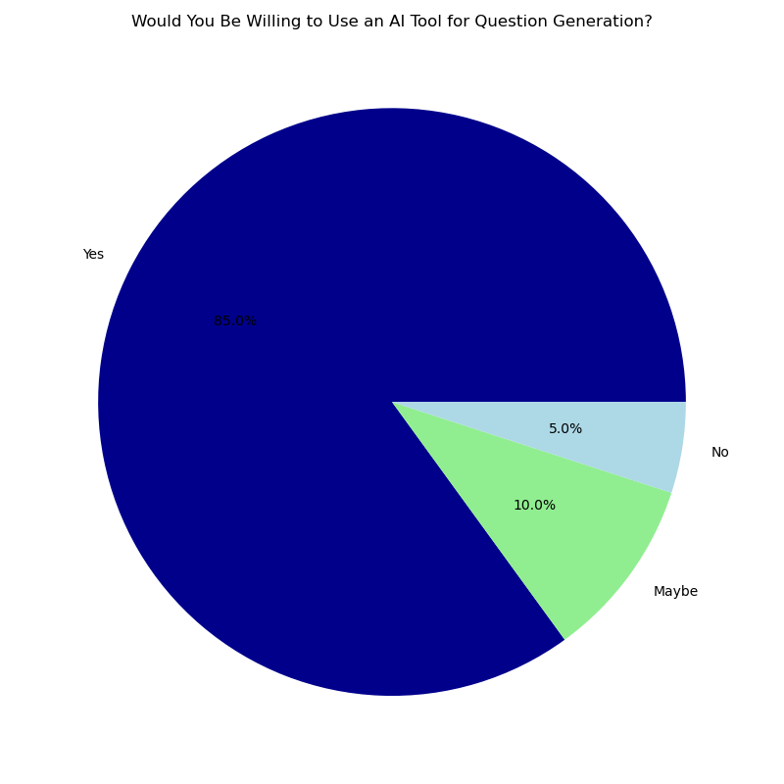
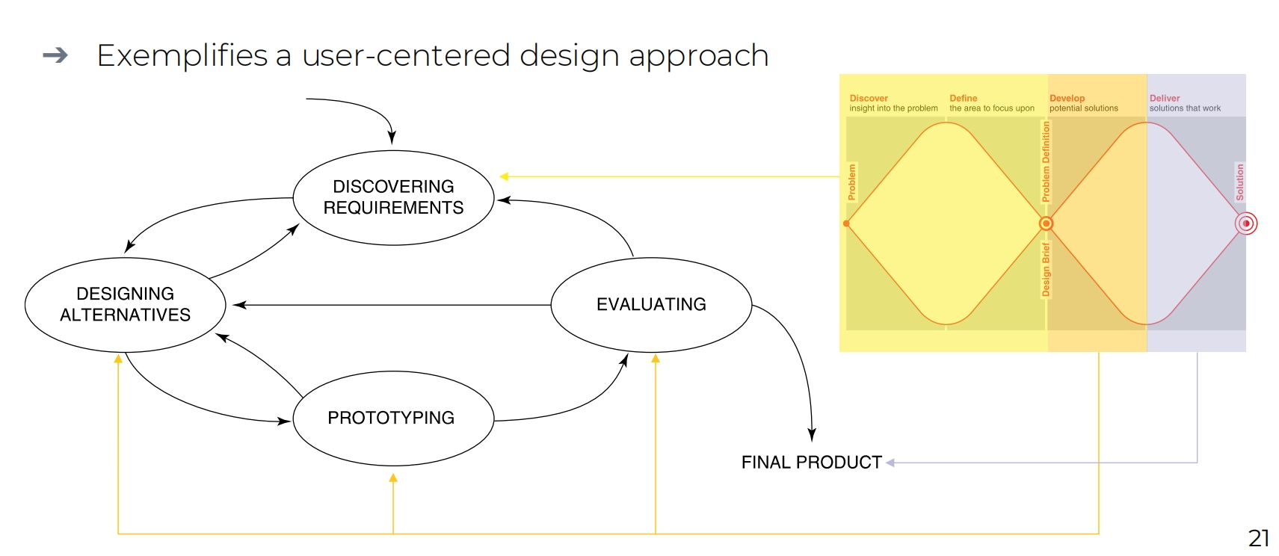
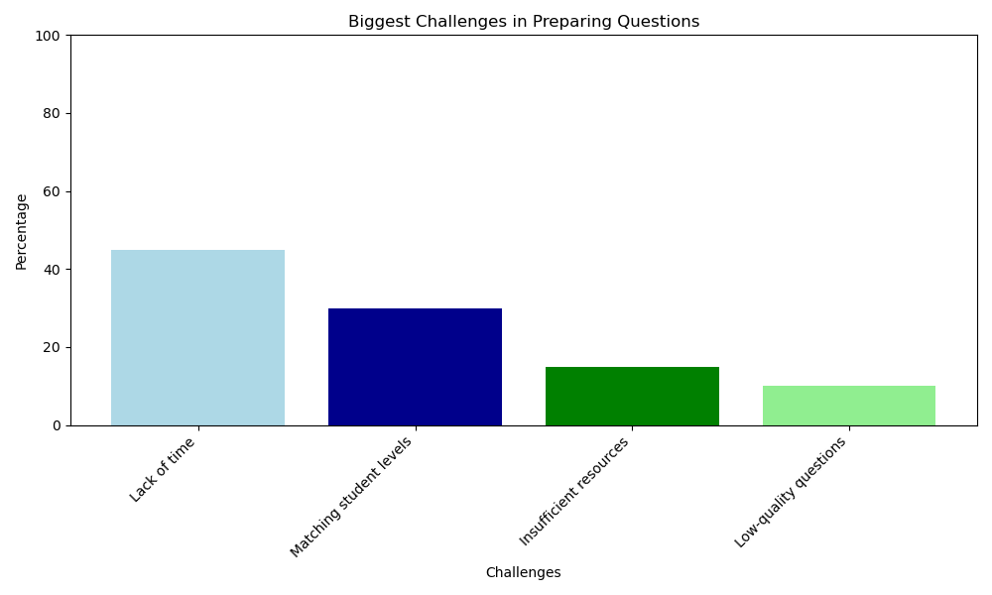
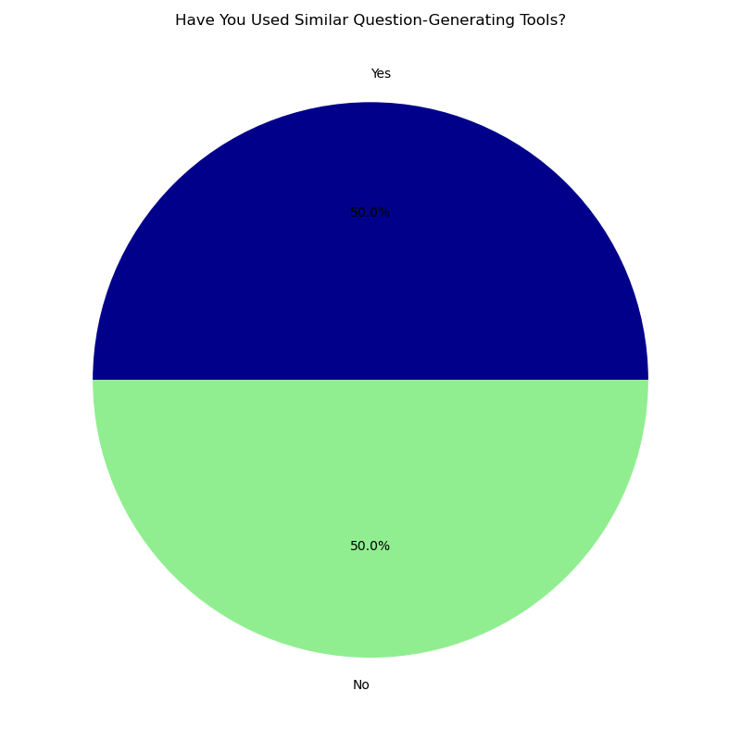
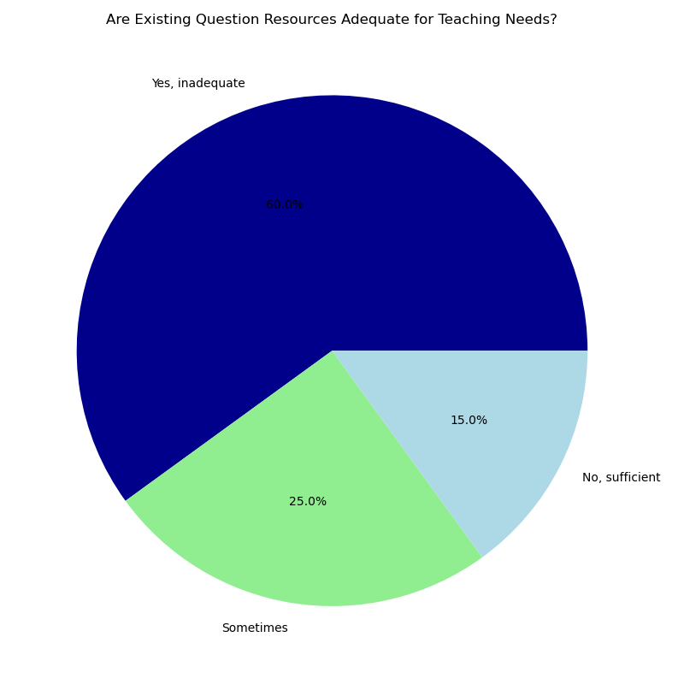

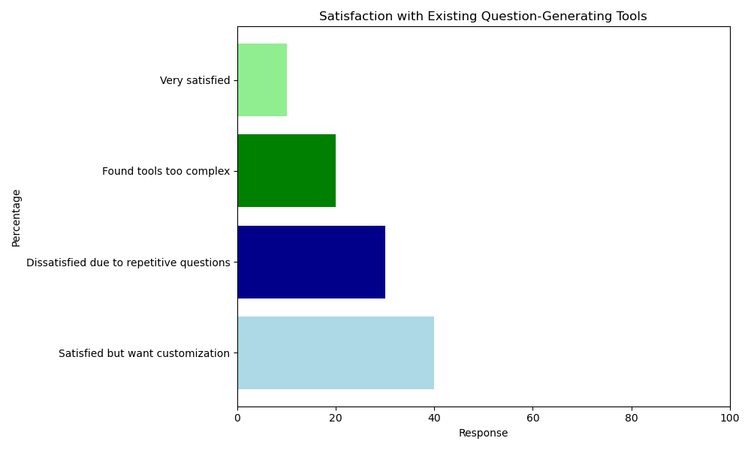
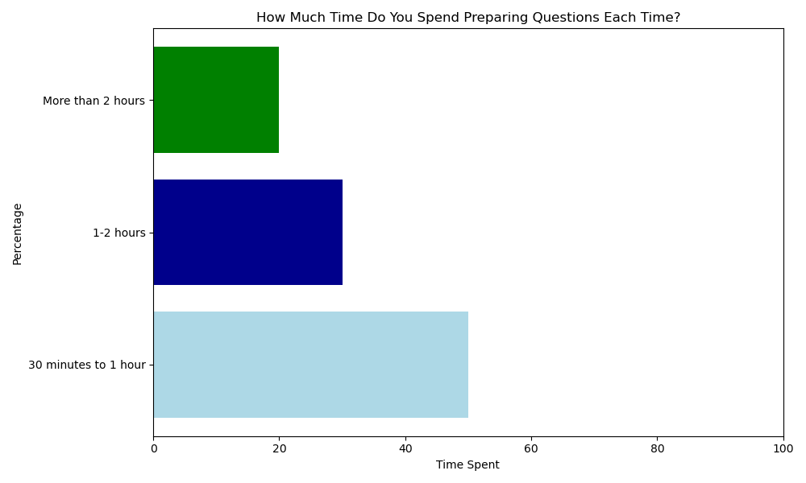
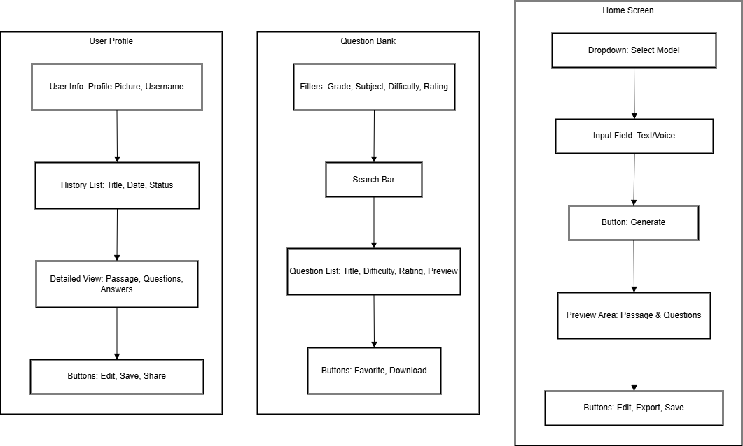
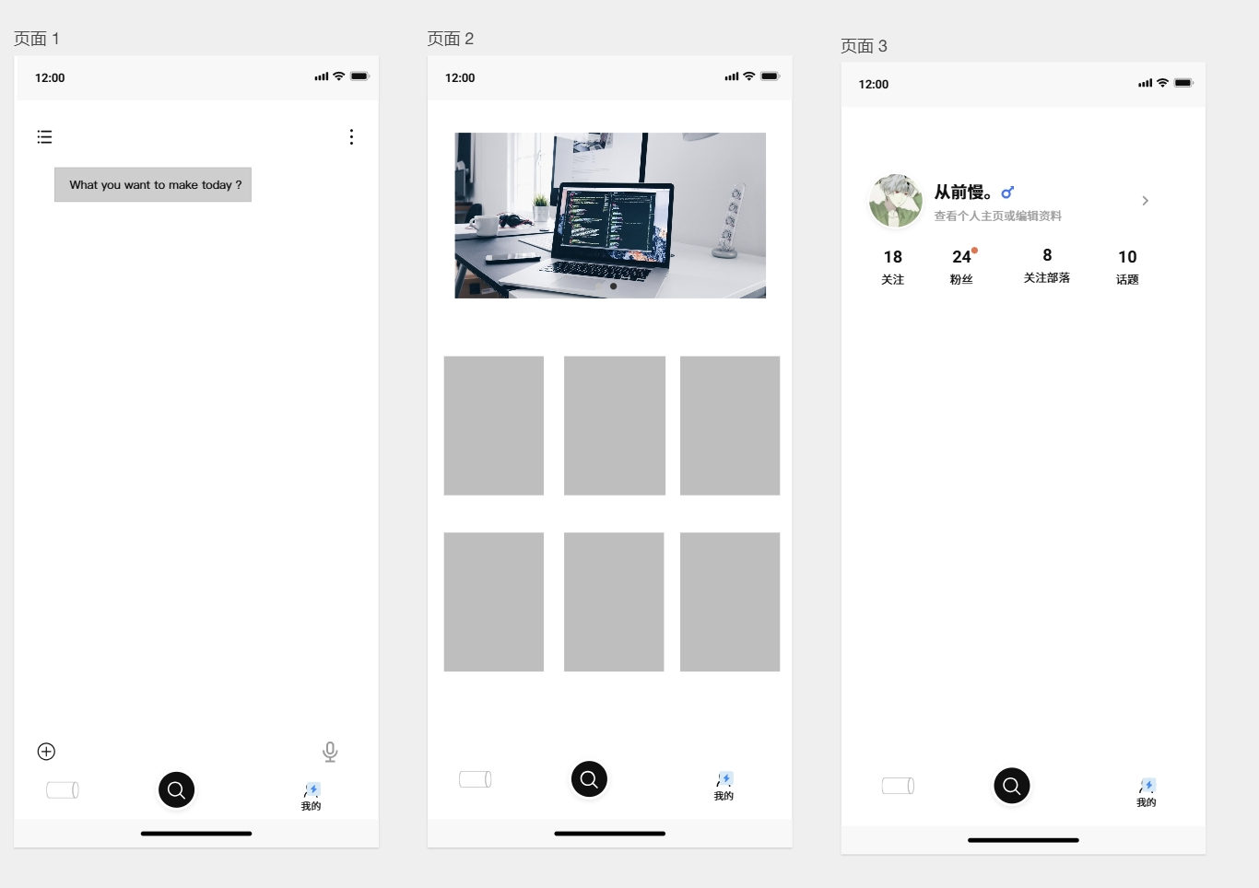
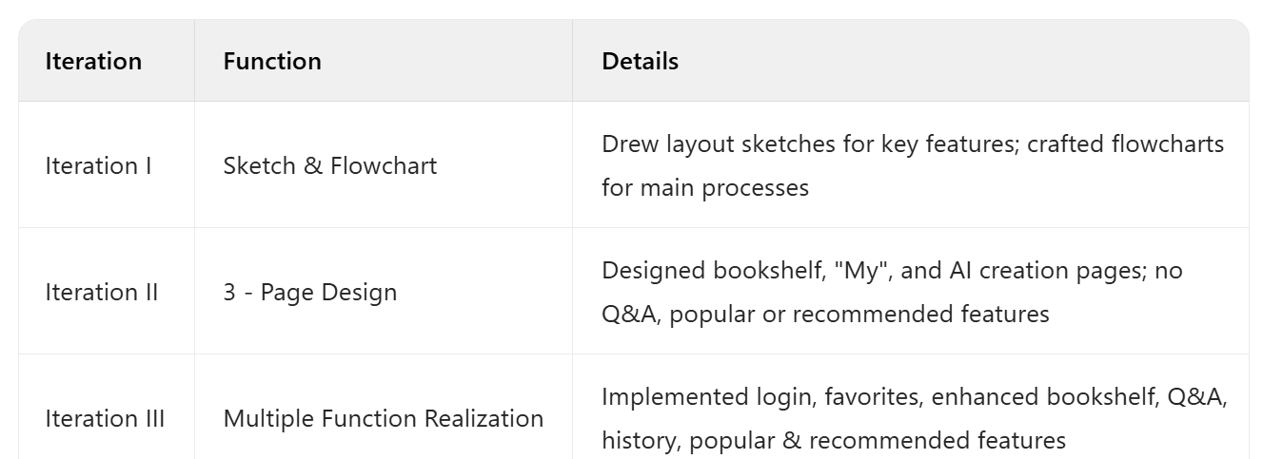
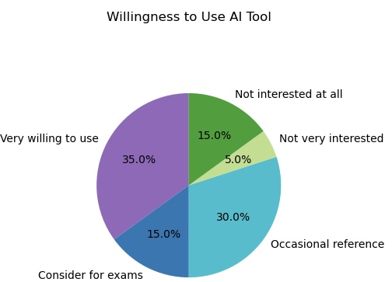
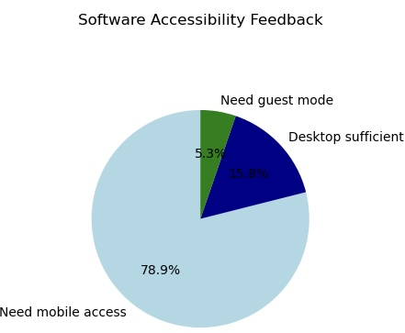
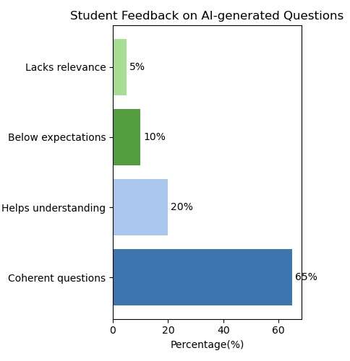
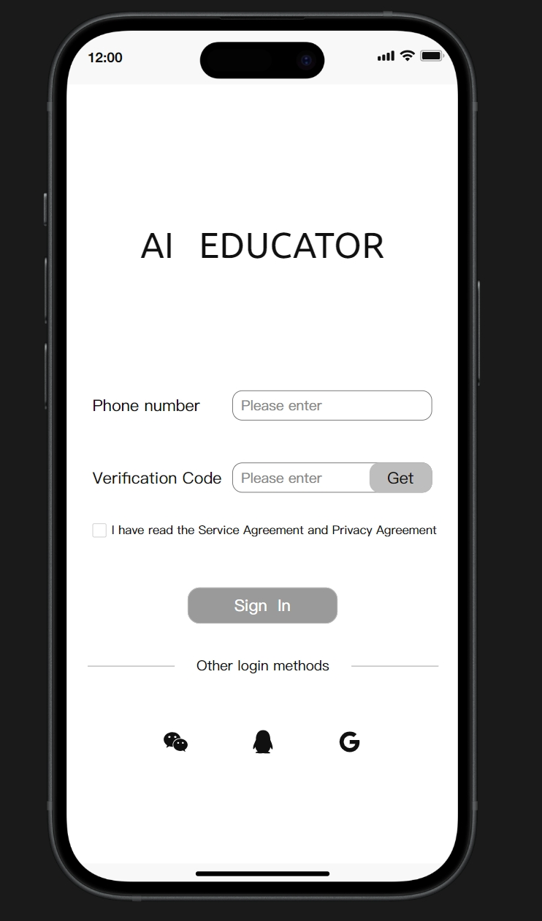
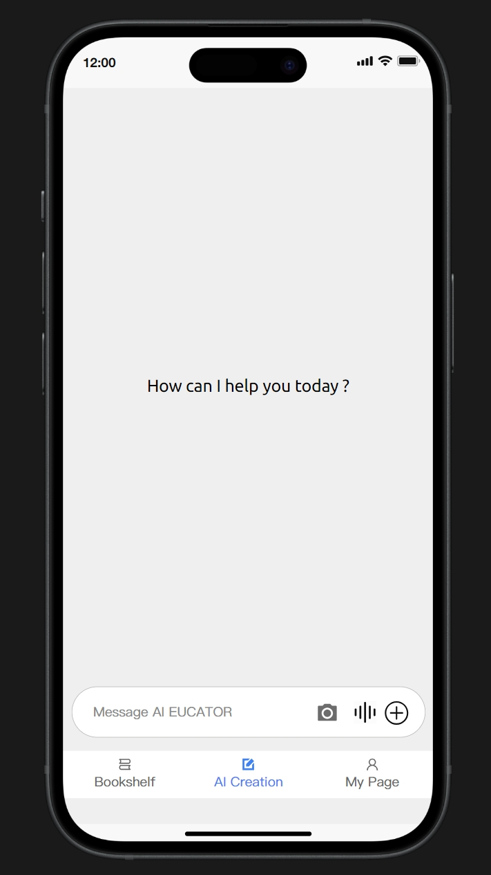
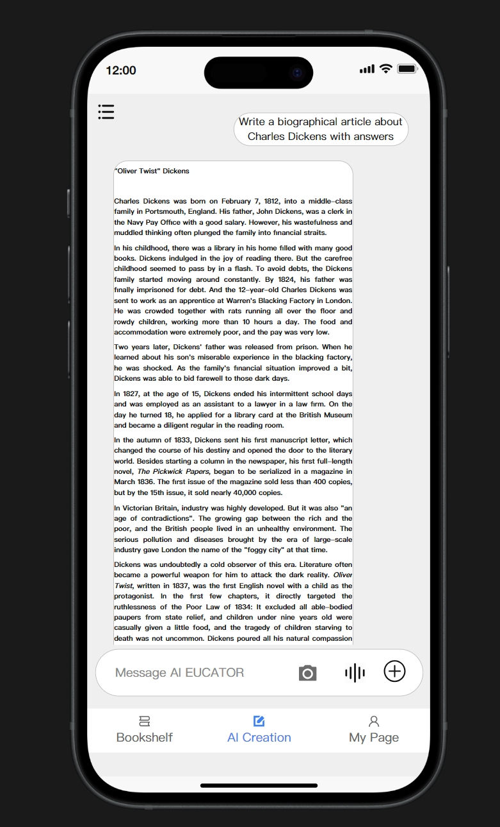
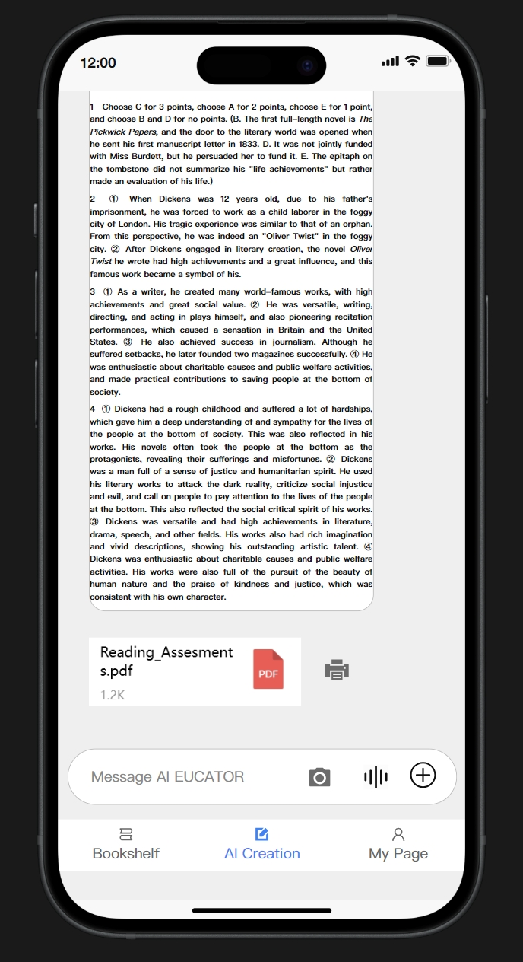
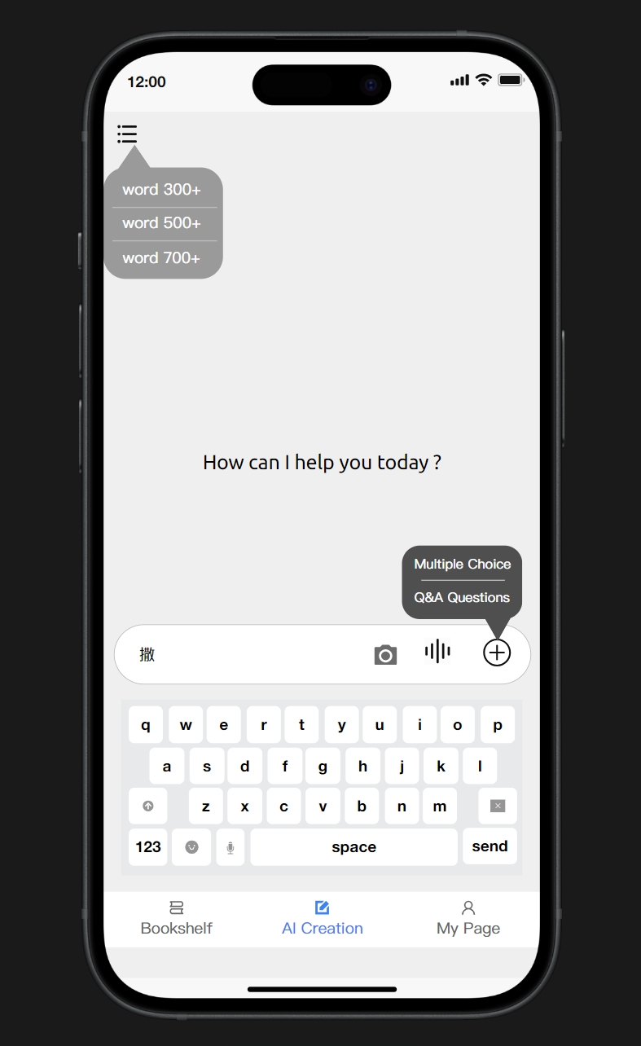
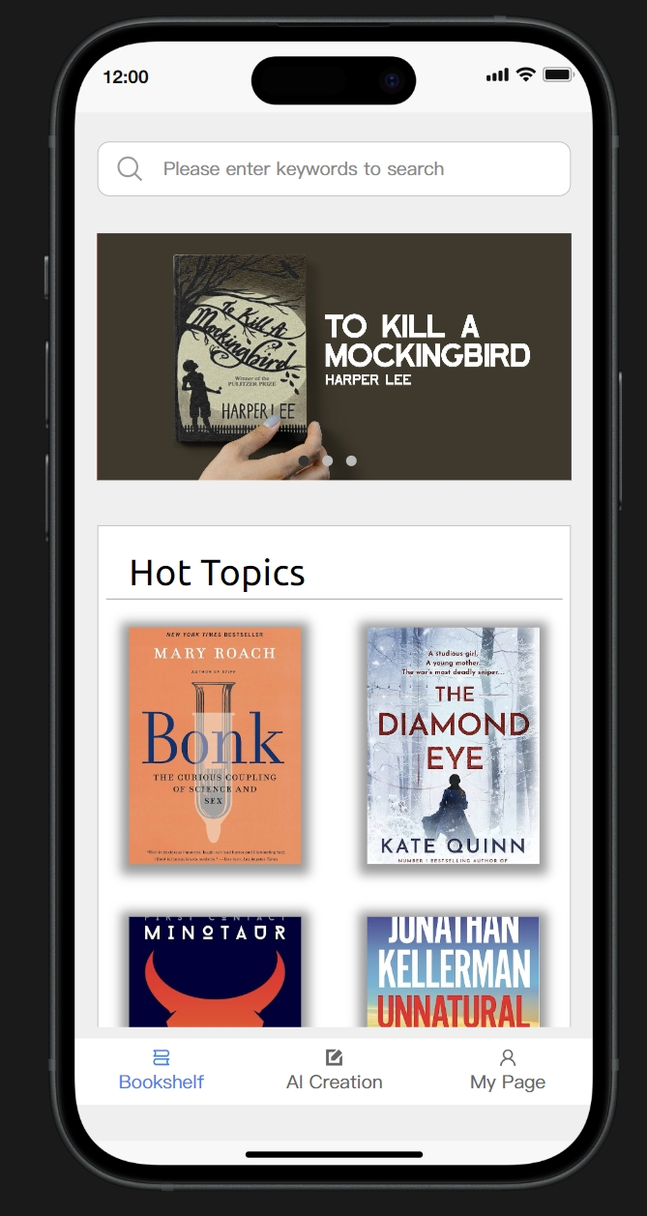
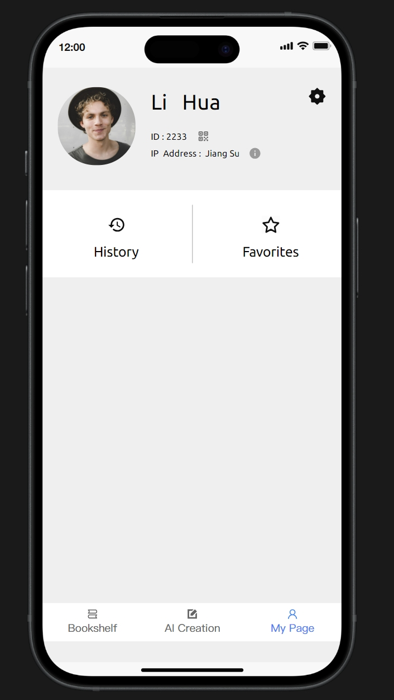

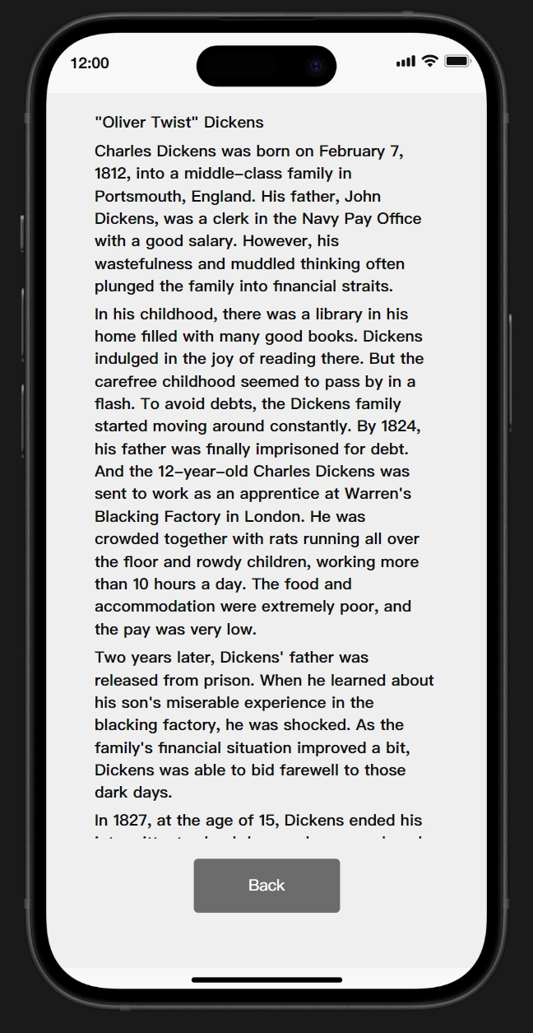
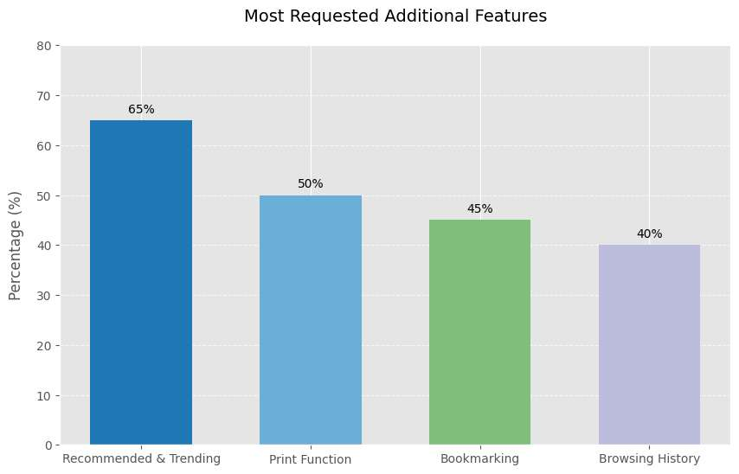
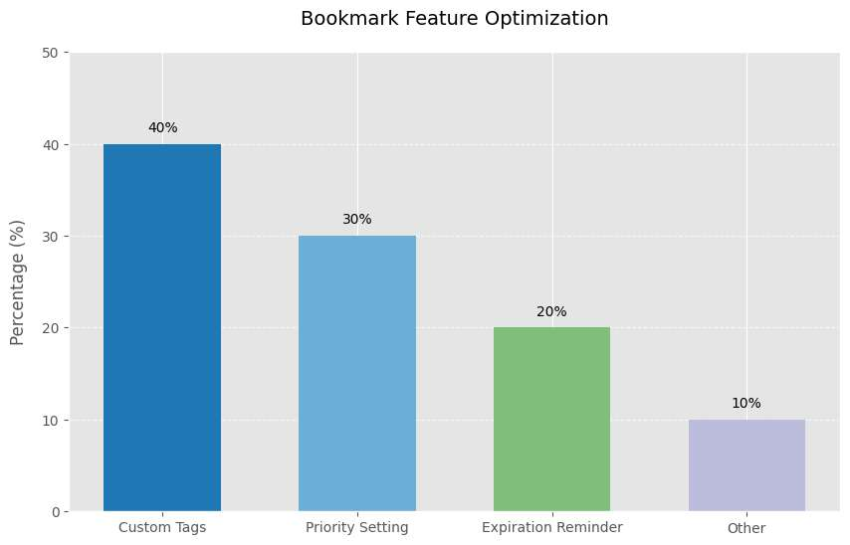
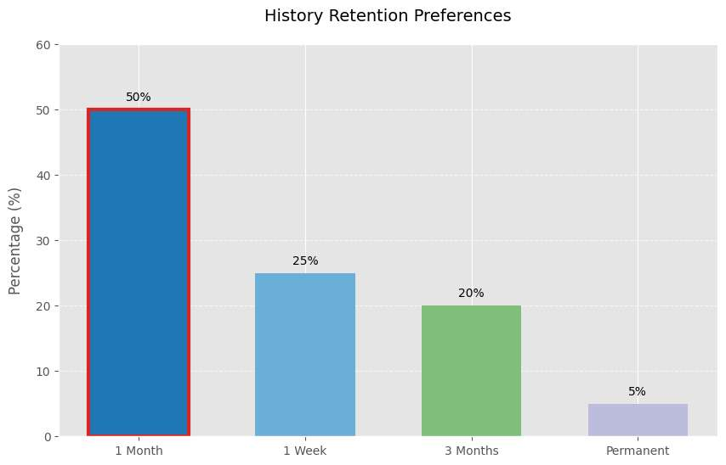
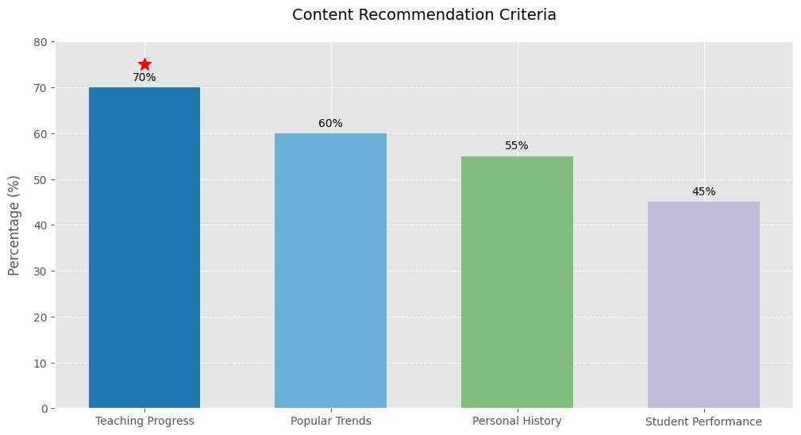
AI Educator: Revolutionizing English Reading Comprehension Question Creation for Teachers
Group 43 Project Member : Yongtai Li 2144072 Zichen Qiu 2252705 Xu Chen 2257453 Sirui Zhang 1929648
Module Name: CPT208 Human-Centric Computing
Abstract
Introduction and Problem Statement
This paper presents the development project of an English learning application. The app has implemented basic functions such as login, favorites, bookshelf management, and can generate reading materials and question answers according to user settings. However, the project has limitations such as poor accuracy of the question - answering module, insufficient refinement of customization, and room for performance improvement. In the future, plans include optimizing the question - answering algorithm, improving customization, enhancing performance, and adding social sharing features to promote collaborative learning.​
Topics (Generative AI in X ) :
The domain is English language education, specifically focusing on the teaching process of English reading comprehension in educational institutions.
Specific Problem and its importance:
English teachers often face the challenge of creating high - quality reading comprehension questions. Manually generating such questions is a time - consuming task. Teachers need to search for appropriate reading materials, design questions that test different cognitive levels, and ensure the questions are relevant to the curriculum and the students' proficiency levels. This process can be extremely labor - intensive [1], especially when teachers have to prepare multiple sets of questions for different classes or assessment purposes.​ Well - designed questions can effectively assess students' understanding of the text, promote critical thinking, and guide students to improve their reading skills. (Go to the Requirements section to show your evidence)
Relation to Human - Centric Computing:
The project takes HCC as its methodological cornerstone, constructing a "tools as extensions" human-computer collaboration through the path of "explicit identification of user needs → cognitive alignment of interaction design → value-added empowerment through technology". This design not only meets teachers' efficiency needs but also enhances their professional development needs, ultimately aiming for the optimization of an educational ecosystem centered on teachers and further on students.
Requirements
Iteration 1
Design and Methodology
Target Users: English teachers in various educational institutions, including primary schools, middle schools, and high schools.
Data analysis to obtain key requirements:(from Requirement Sections)
Iteration 1 ----Time Efficiency: Teachers often have a heavy workload, juggling multiple classes and lesson preparations. Manually creating reading comprehension questions, grammar exercises, and vocabulary quizzes is extremely time consuming. They need a tool that can generate high quality questions in a fraction of the time it currently takes them. ----Customization: Every classroom has a diverse range of students with different proficiency levels and learning needs. Teachers require a tool that allows them to customize questions according to specific teaching objectives, student abilities, and curriculum standards.
Iteration 2 ---- Mobile App Preference: As teachers are often on - the - go, either moving between classrooms, attending meetings, or working from home, a web - based tool may not always be convenient. A mobile app would offer them the flexibility to access and use the question - generation tool at any time, without the need for a stable internet connection in all scenarios (if the app has some offline capabilities). It also allows for quicker access compared to opening a web browser and navigating to a specific website.
Iteration 3 ---- History Record: Teachers may want to keep track of the questions they have previously generated. ----Favorite Feature: allows them to mark these questions for easy access later. ----Print Function: In many educational settings, printed materials are still the norm. Teachers need the ability to print out the generated questions, along with answer keys if applicable. ----Recommended and Popular Questions: To inspire and assist teachers in creating better questions, they would benefit from seeing what other educators consider to be effective questions.
Design Process : Each iteration follows a three - step process:
1 Discovering requirements & Designing alternatives: Choose one of the requirements found in discovery that meets it in designing alternatives and achieve the design in a conceptual way.
2 Prototyping: Realize alternative design through demonstration video or code to facilitate the display effect to target users.
3 Evaluating: Evaluation through prototype, and heuristic evaluation, interview, and other evaluation methods are used. Improvement will be made in the next iteration.
Iteration Design LIfecycle model
Design Alternatives:
Teamwork attendance
Iteration 2
Iteration 1
Iteration 2
Process of three Iterations
Implementation and Outcomes:
Key Features :
Secure Login
Convenient Favorites
Bookshelf Management
Q&A Interaction
Customizable Question Types
History Tracking
Iteration 3
Conclusion and Future Work:
Evaluations
Our app now offers essential features such as secure login, a functional bookshelf, and basic content generation. These features have provided users with a starting point for efficient study and content management, addressing initial user needs like access control and resource organization. However, the question - answering module's accuracy remains inconsistent, often providing subpar answers. The customization options, though present, lack finesse in truly tailoring to diverse user preferences. Also, the app's performance can be sluggish, especially when handling large reading materials. In the future, we aim to enhance the question and use deepseek api to realize a true prototype.
In terms of evaluation, the most traditional method is to only consider the time spent by teachers. According to the survey, the time spent has been reduced to a certain extent, proving the effectiveness of this software. More modern evaluation methods require students to participate as well. According to Solmaz Ghaffarian Asl’s paper, data such as the Students’ Course-instructor Evaluation survey (SCE) and students’ final exam scores of the courses taught by teachers are required. Then a mathematical model is established from the data to finally determine whether this software has greatly affected the efficiency of teachers’ teaching.
Heuristic evaluation :This generative AI project enhances English language education by democratizing access to adaptive teaching resources, particularly benefiting underserved educators and learners. Its intuitive interface reduces lesson preparation time while improving learner self-efficacy. By addressing regional linguistic challenges, the tool bridges global skill gaps and advances inclusive education, aligning with UN Sustainable Development Goal 4.
Iteration 3
Reference:
Day, R. R., & Park, J. S. (2005). Developing Reading Comprehension Questions. Reading in a foreign language, 17(1), 60-73.
Ghaffarian Asl, S., & Osam, N. (2021). A study of teacher performance in English for academic purposes course: Evaluating efficiency. Sage Open, 11(4), 21582440211050386.
Monroe, W. S., & Clark, J. A. (1924). Measuring teaching efficiency. Bulletin (Bureau of Educational Research); no. 025.

